Slide 1

Welcome
Network Architecture

Slide 2
For LL and BB ENT Customer
TDN IBW (sale delivered and installed by TDN Team)
TIL IBW (Sale by TIL Team and installed by TDN Team)
TIL LM/TCL/Airtel/Aircel/Vodafone ( B/W and services provide by TIL and RF path installed by TDN)
P2P (TDN RF path)
Wi-Fi customer (AP and Wi-Fi devices (Gemtek,CPE,Nano installed by TDN team)
Hotel Solution (provide Wi-Fi devices MSC/MSG for coupons generation)
ENT BB (BB plan but link delivered though ENT RF path)
Other BSO (RF path provide by other ISP and service handled by Tikona)

Slide 3







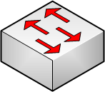

Network Architecture Of TDN
P2P Link
PBN Site
FBN Site
Root AP
Root AP
Fiber Cloud
Mesh AP
NMAP
Aggregation Switch
Ruckus CPE
SBN/User
User
Core router

Slide 4
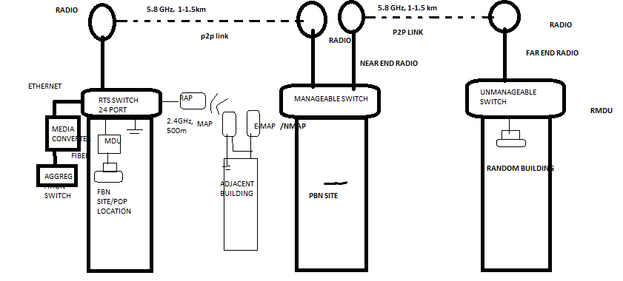

Slide 5

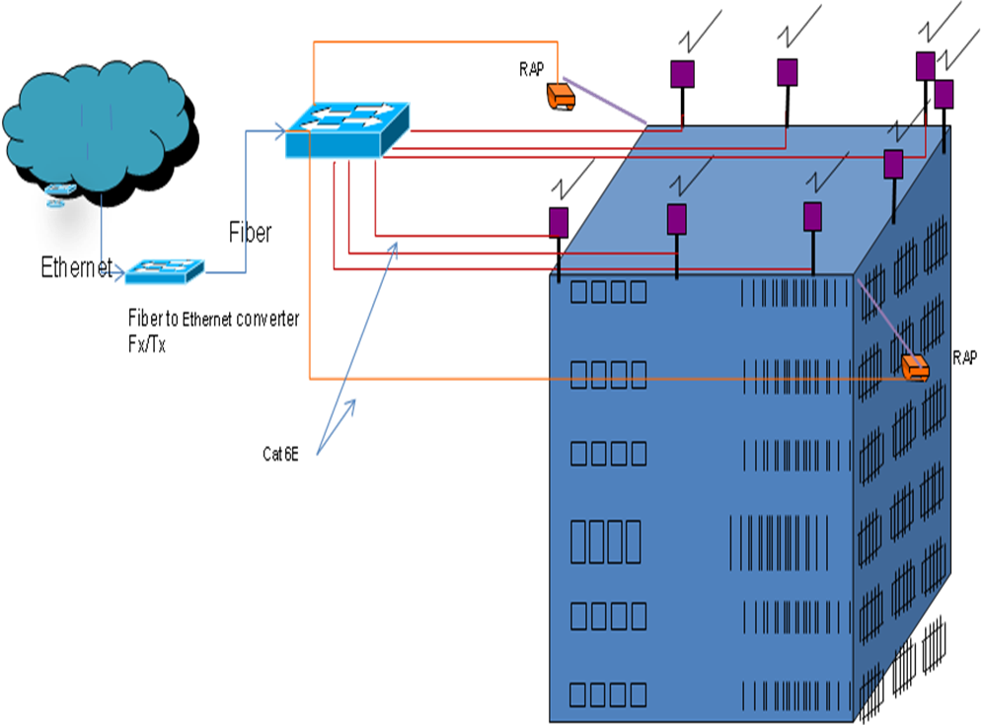

Slide 6

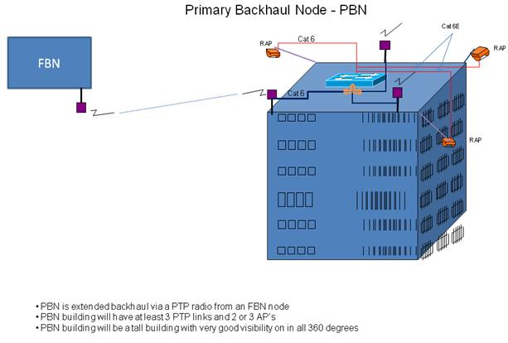

Slide 7
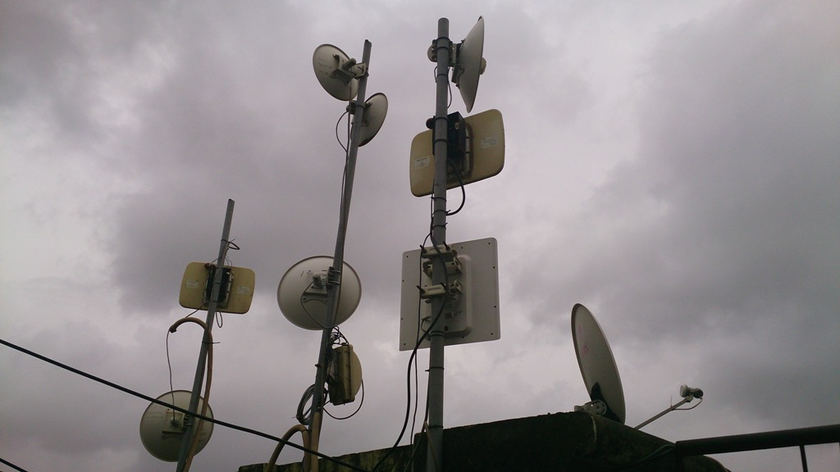

Slide 8
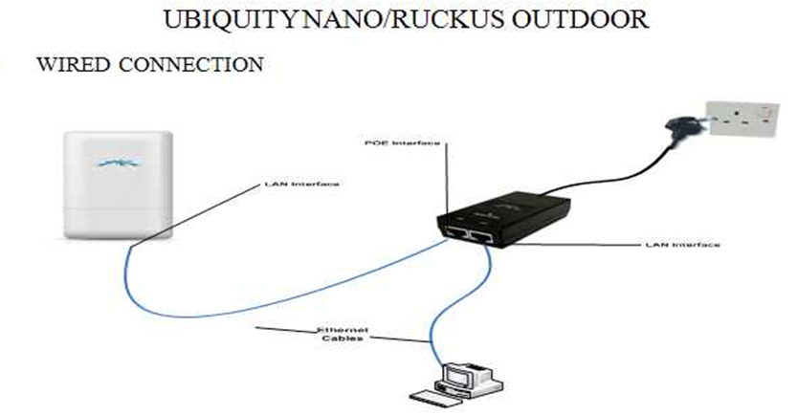
MAC ADDRESS SERIES
UBIQUITY NANO | RUCKUS OUTDOOR (MODEL7211)
00:15:XX:XX:XX:XX | 74:91:XX:XX:XX:XX
00:27:XX:XX:XX:XX | C0:C5:XX:XX:XX:XX

Slide 9
Network Infrastructure continued…
FBN (Fiber Backhaul Node / Access POP)
FBN Is usually located on the tallest building
This node will be connected to the Backhaul Bandwidth on Fiber
  This site has 360 degree clear line off site where radios are installed.
PBN (Primary Backhaul Node )
This node is directly connected to the FBN with 5.8GHz Point to Point link
It is used to extend the backhaul from FBN to all the Cluster
This node will be generally a tall building with the possibility of very good visibility in 360

Slide 10
Network Infrastructure continued…
Servers: Tikona has 5 servers which are as follows:
  MSC: Master service controller which is also called as multiple service controller as it controls multiple services
  DNS: Domain name server which converts host name to IP address and IP address to the host name
  DHCP: Dynamic host configuration protocol. DHCP assigns IP address dynamically
  AAA: Authentication authorization accounting. It authenticates the user and MSC assigns the services accordingly on the established session.
  LDAP: Light weight directory access protocol. It validates all billing related services of user and basic information.

Slide 11
TIKONA uses 3 series of IP addresses:
1.22.x.x, 1.23.x.x and 113.193.x.x , 123.x.x.x(Public)
10.x.x.x, 100.x.x.x (Private)

